Slide 1

AWS Dev
Cloudwatch

Slide 2
Cloudwatch
Monitoring service for AWS resources, and your apps running on AWS
Monitors:
Compute
Storage and Content delivery
Databases
Default Monitoring:
Host level metrics: CPU, Network, Disk (I/O), Status check
RAM utilization is a custom metric. Default is 5 minute monitoring, detailed monitoring if enabled is every 1 minute
You can retrieve data from terminated instances getmetricsstatistics
Logs stored indefinitely, can be changed
Can be used on prem using SSM agent

Slide 3

Alarms
Monitors metrics and triggers action to be taken

Slide 4
Custom Metrics
Min granularity – 1 min
Download CW monitoring scripts - curl https://aws-cloudwatch.s3.amazonaws.com/downloads/CloudWatchMonitoringScripts-1.2.2.zip -O unzip CloudWatchMonitoringScripts-1.2.2.zip
Commands to setup custom metrics
/home/ec2-user/aws-scripts-mon/mon-put-instance-data.pl --mem-util --verify --verbose
/home/ec2-user/aws-scripts-mon/mon-put-instance-data.pl --mem-util --mem-used --mem-avail
*/1 * * * * root /home/ec2-user/aws-scripts-mon/mon-put-instance-data.pl --mem-util --mem-used --mem-avail

Slide 5
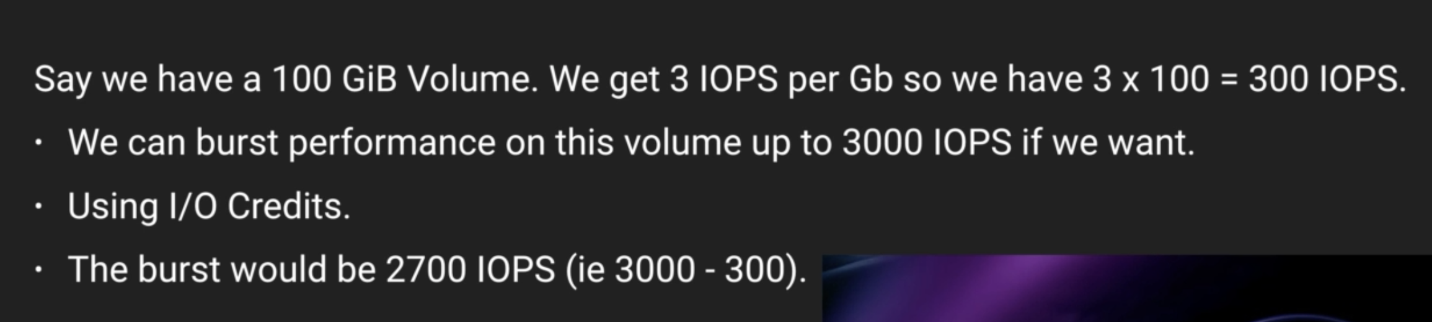
IOPS Calculation and burst for 30 minutes

Slide 6
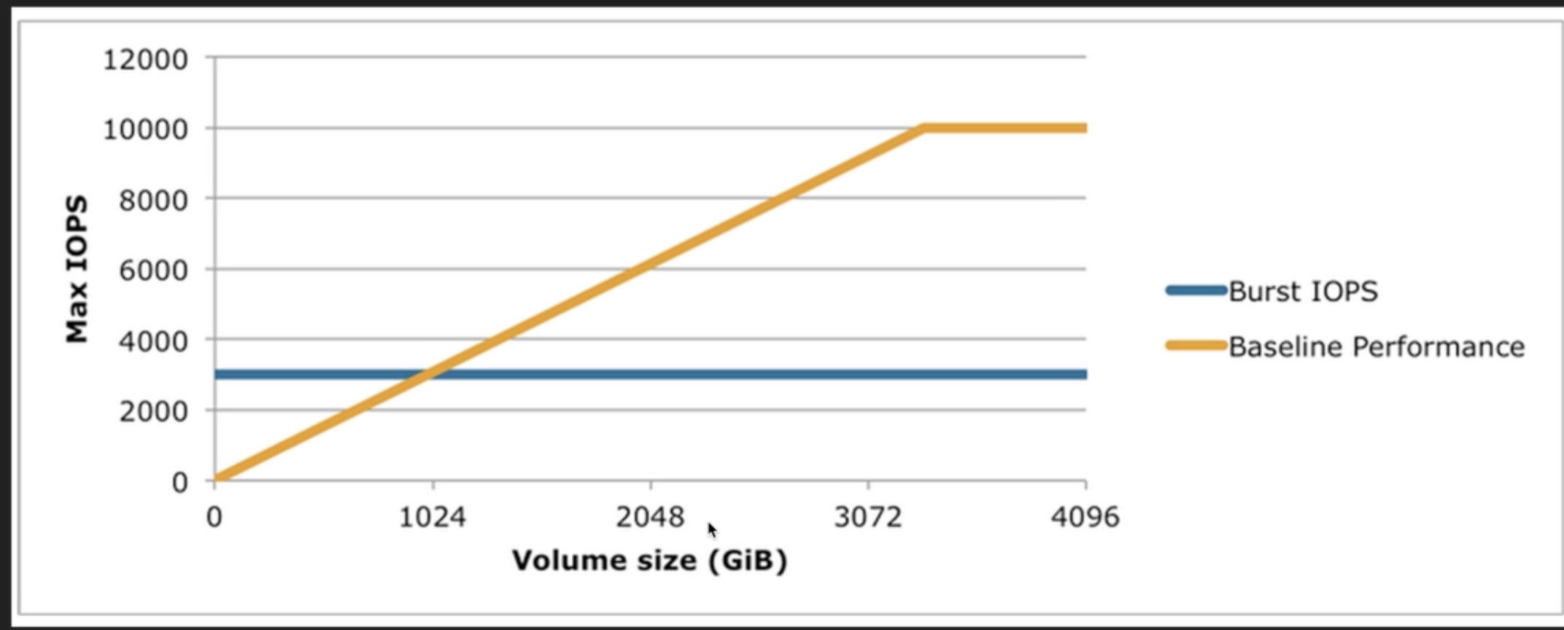
Choosing volume size

Slide 7

gp2
Up to 10000 IOPS
Anything above – provisioned IOPS

Slide 8
EBS initialize
Pre-warm is volume created from snapshot
Run lsblk
Run sudo dd if=/dev/xvdf of=/dev/null bs=1M

Slide 9
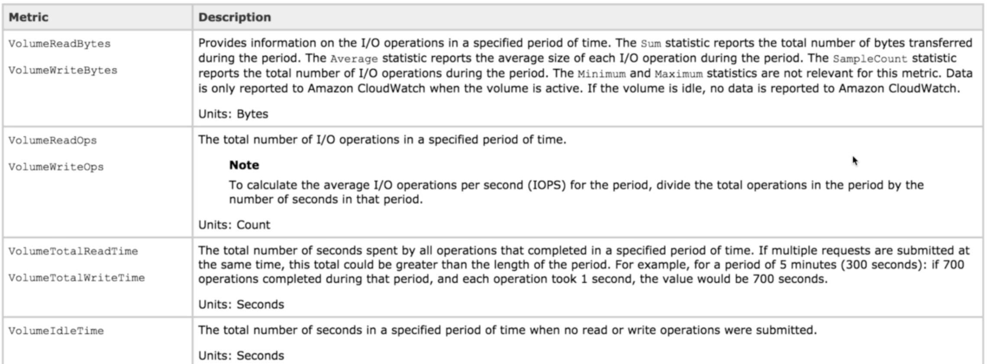
Volume metrics

Slide 10
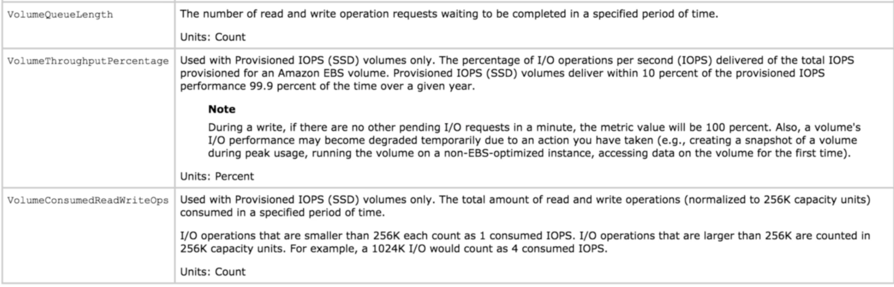
Volume metrics

Slide 11
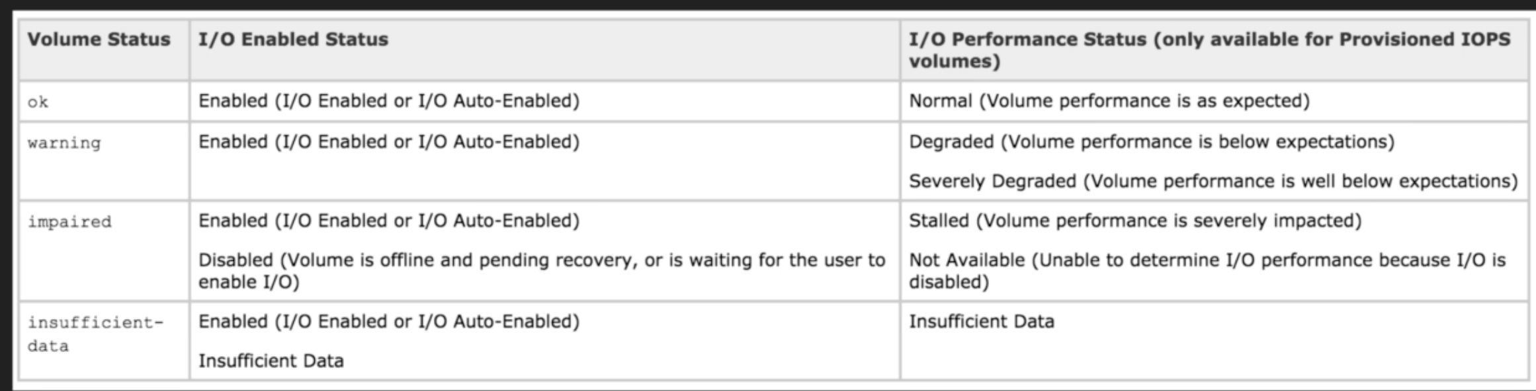
Volume status checks

Slide 12
EBS Modification
Can be done on the fly

Slide 13
ELB
CW Metrics created as soon as ELB created
Access logs – detailed info on requests sent to your ELB – client Ips, latencies, request paths, and server responses
Access logs – stored in S3 bucket, compressed, can be queried using Athena or 3rd party tool like sumologic
Access logs – useful to analyze terminated EC2s hitting ALBs
Request tracing – only available in ALB X-Amzn-Trace-Id
Cloudtrail – capture calls made to ELB API, can be stored on S3 as log files, source of IP, when call was made

Slide 14

Elasticache monitoring
2 engines:
Memcached
Redis
Monitoring:
CPU Utilization
Swap Usage
Evictions
Concurrent connections

Slide 15
CPU
Memcached
Multi threaded
Can handle loads of upto 90%. If more than 90%, add more nodes to cluster
Redis
Not multi threaded. Take 90 and divide by number of cores. That’s when you scale.

Slide 16
Swap usage
Memory reserved on disk in case your run out to RAM. Size = size of RAM
Memchached
Should be around 0, not to exceed 50 MB
Memcached_connections_overhead defines reserved memory
Redis
No SwapUsage metric, instead use reserved-memory

Slide 17
Evictions
Memcached
No recommended setting
Scale up or scale out
Redis
No recommended setting
Only scale out (add more nodes/replicas)

Slide 18
Concurrent connections
Memcached & Redis
No recommended setting.
Could mean there is spike in traffic or app is not releasing connections as it should
Set an alarm on number of concurrent connections

Slide 19
CW Dashboards
Are inter region
Switch regions to add widgets to same dashboard
Cross region widgets can be displayed within dashboard in any region

Slide 20
AWS Organizations
Allows you to manage multiple AWS accounts
Centrally manage groups of a/c and policies in a/c
Control access to AWS services using Service Control Policies (SCP)
SCP overrides IAM access
Automate a/c creation and management
Consolidate billing across a/c

Slide 21
Resource groups
Classic groups – cross region (global)
AWS Systems manager – per region basis, can do automation, view insights on inventory

Slide 22
AWS Config
Service that gives Resource inventory, config history, change notifications to enable security
Configuration snapshots, automated compliance check

Slide 23
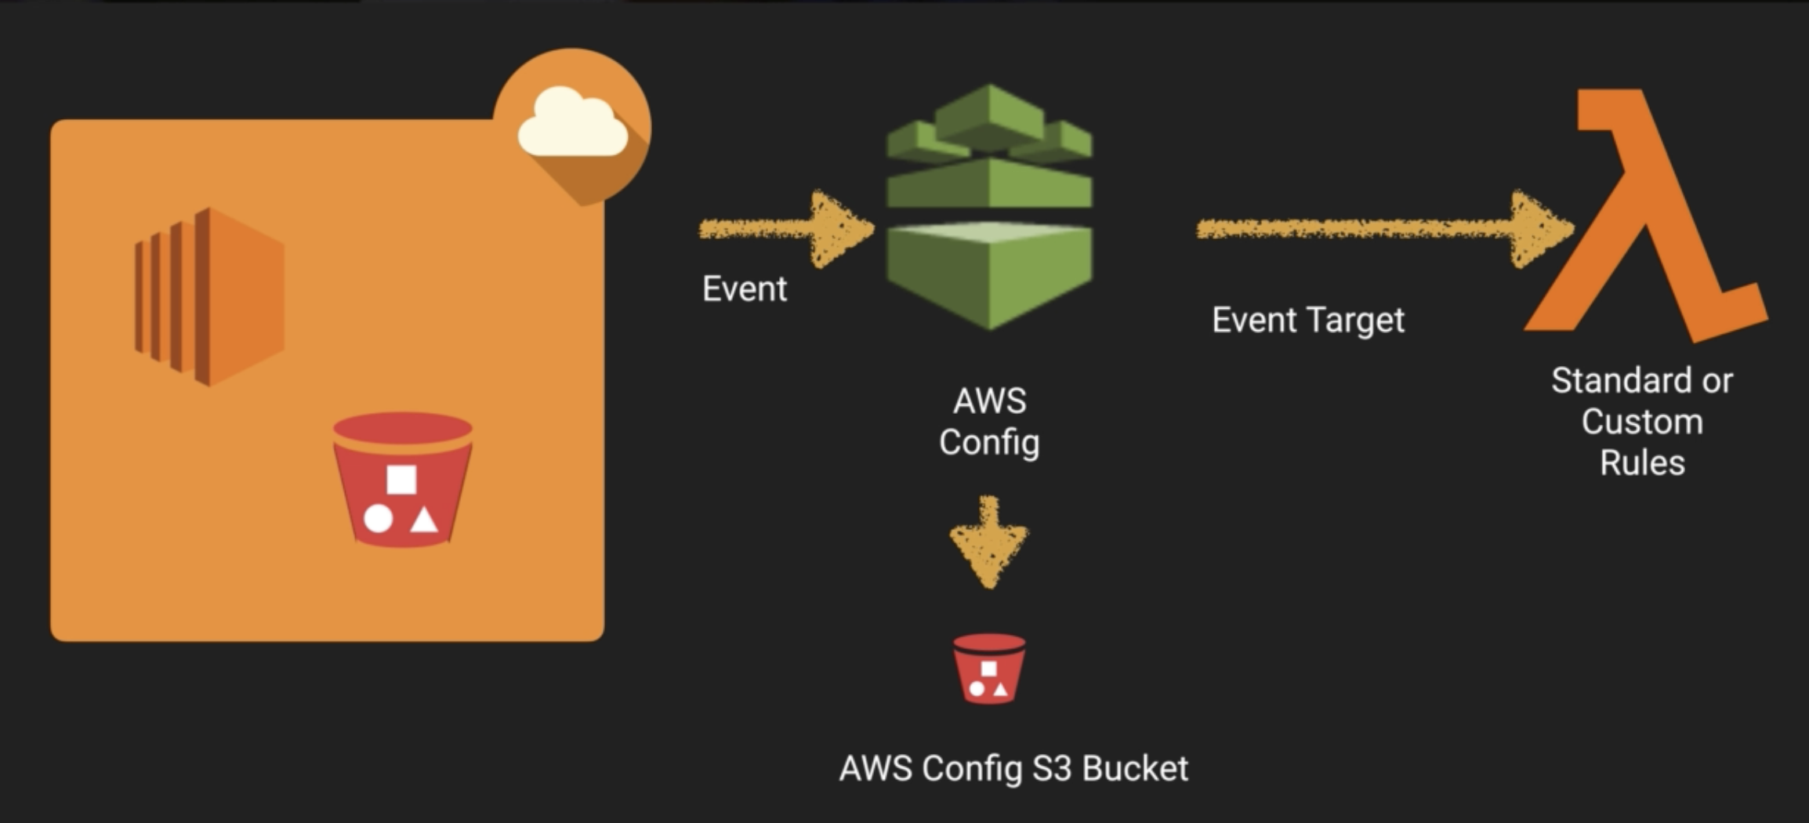
AWS config flow

Slide 24
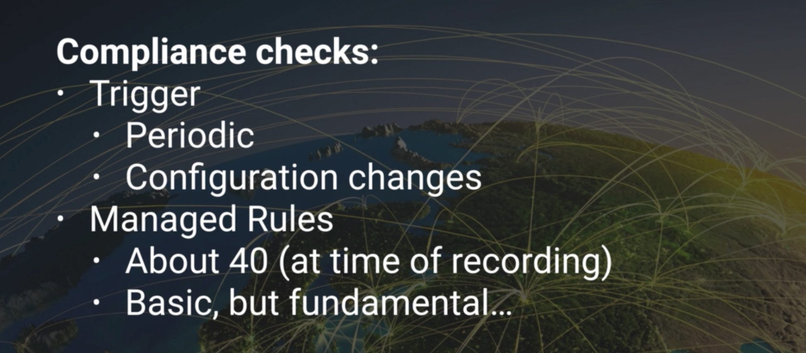

Slide 25
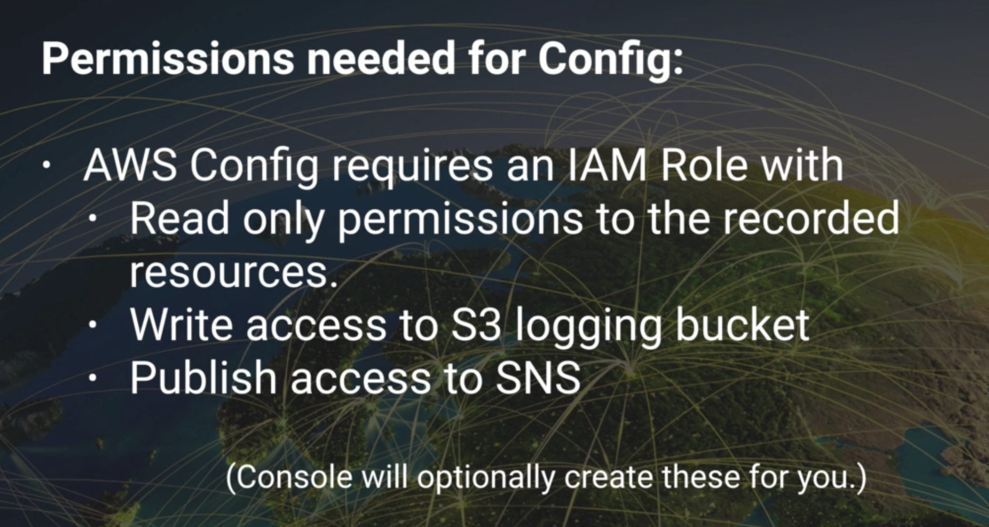

Slide 26
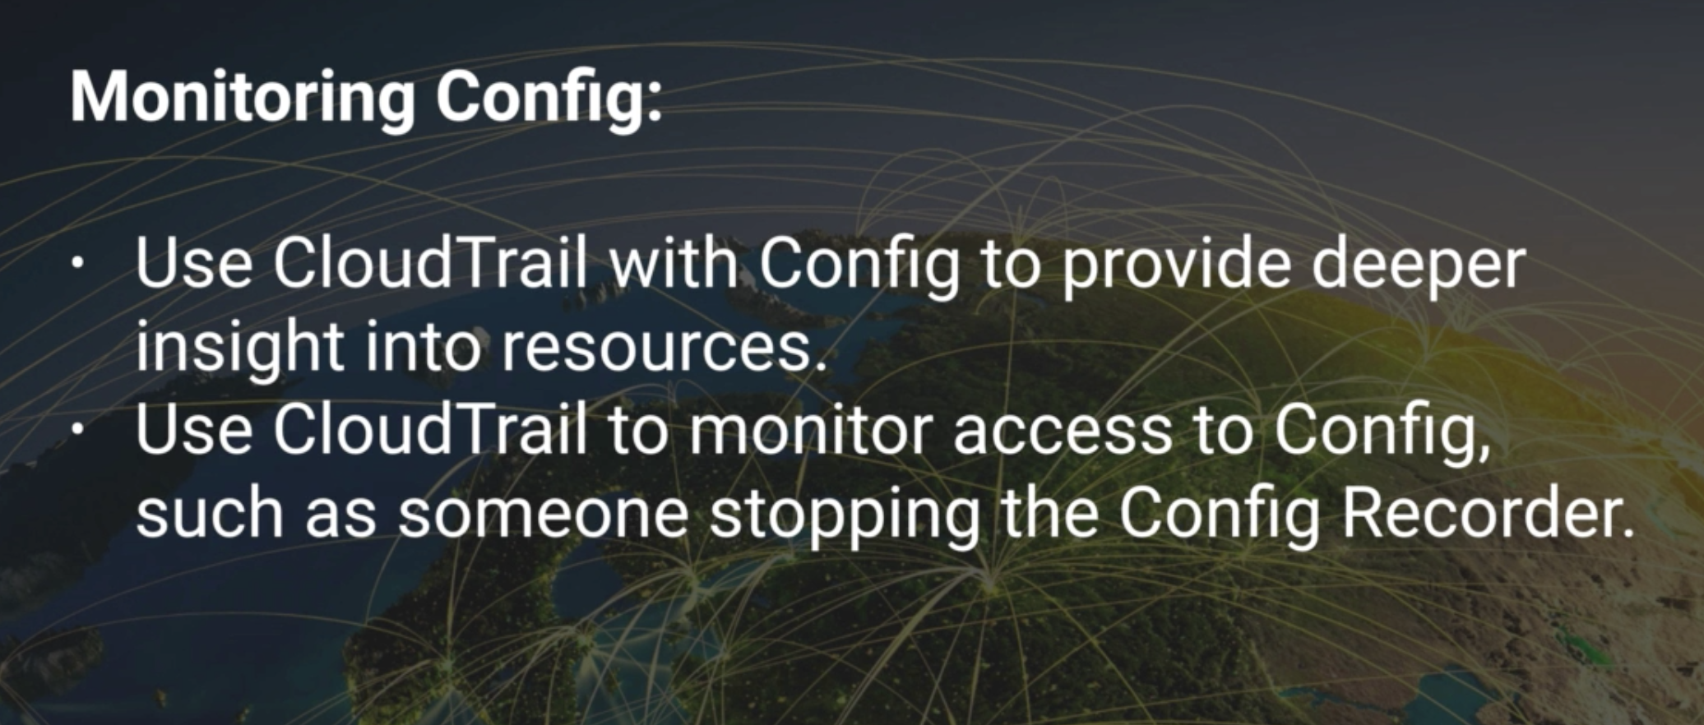

Slide 27
CW FAQ
Works with any OS
Alarms watch metrics and send notification to SNS or ASG when set threshold in metric exceeds
CW Logs – real time system and application monitoring

